Slide 1


Smart Cache Insertion and Promotion Policy for Content Delivery Networks
Peng Wang∗, Yu Liu†, Zhelong Zhao †, Ke Zhou∗, Zhihai Huang‡, Yanxiong Chen‡
∗WNLO, HUST †HUST ‡Tencent
International Conference on Parallel Processing 2023

Slide 2



CDN Caching Goal：Minimize WAN Traffic
Requests
Requests
Hit
User
Edge Cache
Miss
Wide Area Network (WAN) traffic is expensive.
CDN caching goal: reducing WAN traffic and average user access latency by improving cache hit ratio

Slide 3
Replacement algorithms remains challenging
replacement algorithm = Insertion policy + victim selection policy
Victim selection policy are well researched (LRU, LRUK, GDSF, LRB …).
Past replacement algorithms insert incoming objects into the low eviction priority (MRU position in LRU). Based on this assumption: objects that have just been requested usually have a high probability of being reused.

Slide 4
Is this assumption reasonable?
Zero-reuse objects (ZROs) are those that are not accessed from the time they are written to the cache to the time they are evicted from the cache.
The waste of cache resources with limited object hit ratio forces us to find solutions to deal with these ZROs.

Slide 5
Is the hit object always hit?
ZROs with a dynamic state are difficult to predict.
Objects may immediately degrade to ZROs after being hit in the cache. We refer to these hit objects as P-ZROs.

Slide 6
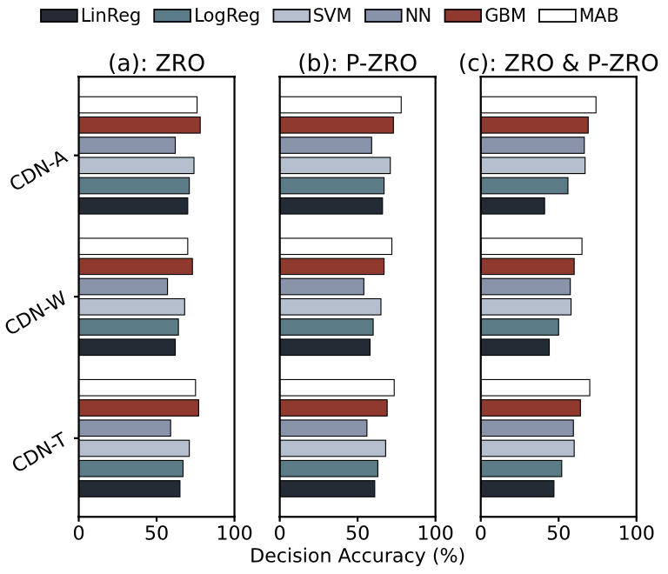
Identify both ZROs and P-ZROs by MAB
The accuracy of all models in identifying both ZROs and P-ZROs is lower than their accuracy in identifying ZROs or P-ZROs.
MAB exhibits advantages in identifying both ZROs and P-ZROs under different workloads.

Slide 7
SCIP design: learning in the MAB framework
We incorporate the MAB framework to learn the function used for position selection. Specifically, SCIP SELECTs from exactly two basic experts, i.e., MRU insertion policy (MIP) and LRU insertion policy (LIP), and learns the probability of insertion into the suitable position, where we use the learning rate to bridge the relationship between the probability and the hit rate.
where generates a real-time random number 𝛾 ∈ [0, 1] for comparing the execution probabilities of LIP and MIP, i.e., 𝜔_{𝑚} and 𝜔_{𝑙} . If 𝜔_{𝑚} > 𝛾, the object will insert into the MRU position; otherwise, the LRU position.
With the continuously varying history lists, it can adapt to the dynamic workload and make decisions.

Slide 8
SCIP design: Judgement with history lists
we set up two history lists, i.e., H_{m} and H_{l} . They store the metadata of evicted objects that were inserted into the MRU and LRU positions, respectively.
Logically, the size of each list is half of the real cache.
We maintain two lists according to the first-in-first-out (FIFO) policy.
If a missing object is hit in two lists, the insertion position of the object should be adjusted.
For example, when the missing object is in H_{l} , it means that the object has a chance to be hit if it is inserted into the MRU position.

Slide 9
SCIP design: Promotion Policy
Hit in cache -> Promote
We can treat the promoted hit objects as special missing objects.
Therefore, when a cache hit occurs and a promotion operation needs to be performed, the action is calculated according to the SELECT function.
The special missing object is inserted according to the action value.

Slide 10


SCIP design: adjust probability when missing
Miss in cache & Hit in H_{m} -> Insert
𝜆 : learning rate
We update 𝜆 with a period of 𝑖.
When the change in hit rates is in the same direction as the change in learning rates, we believe that the learning rate should be amplified to speed up finding better probabilities.
Miss in cache & Hit in H_{l} -> Insert

Slide 11
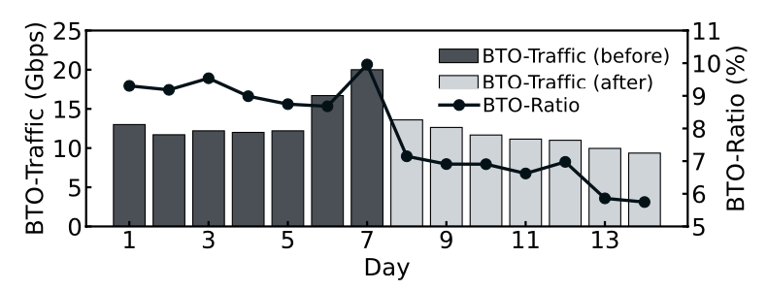
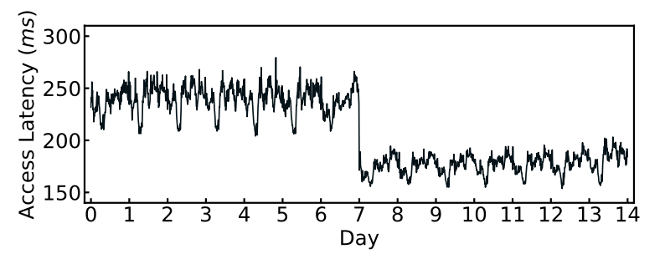
Deployment and performance in real system
We deployed SCIP to Tencent T Disk Cache (TDC), which serves over 2,500 businesses.
In the system, inodes are used to manage metadata of object, including an insertion position variable (𝑖𝑛𝑠𝑒𝑟𝑡_𝑝𝑜𝑠). When an object is written into the MRU/LRU position of the cache, 𝑖𝑛𝑠𝑒𝑟𝑡_𝑝𝑜𝑠 is set to 1 or 0, respectively.
We measured the performance changes in "Backing to Original Source" (BTO) traffic and ratio (BTO-ratio), as well as the average access latency from the monitoring system.

Slide 12
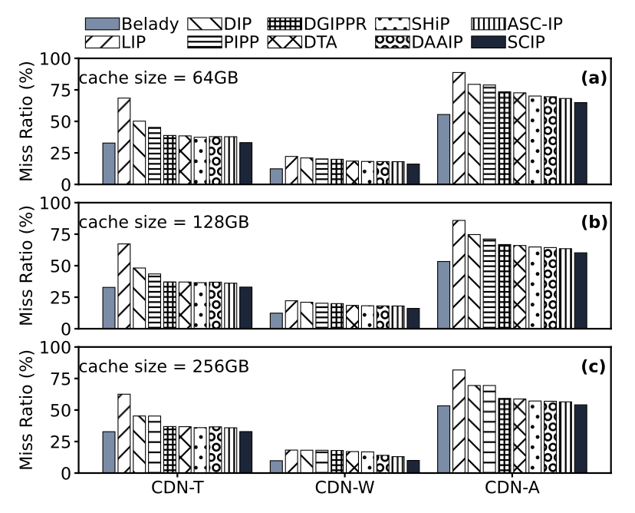
Evaluation SCIP
Compared with insertion and promotion policies
Peak CPU: 0.42% more than the simple heuristic algorithms
Memory overhead : SCIP's memory consumption is only marginally higher than LIP (1.3GB on average), which has the lowest memory consumption
Throughput: SCIP’s TPS generally aligns with PIPP, DGIPPR, DTA, SHiP, and ASC-IP, and surpasses that of DAAIP

Slide 13
Conclusion
SCIP reduces WAN traffic with modest overhead.
Key insight: ZRO and P-ZRO
Simplifies machine learning & reduces system overhead
unify the insertion and promotion policies while ensuring execution efficiency
code: https://github.com/oswald-hust/icpp2023

Slide 14



Thanks！
mail: wp_hust@hust.edu.cn

